Slide 1
SOCIAL DATA MINING
ASSIGNMENT 4
IMAGE CLASSIFICATION
Fatih Bugra Sagiroglu
200469929

Slide 2
AGENDA
Azure portal
Custom vision AI

Slide 3
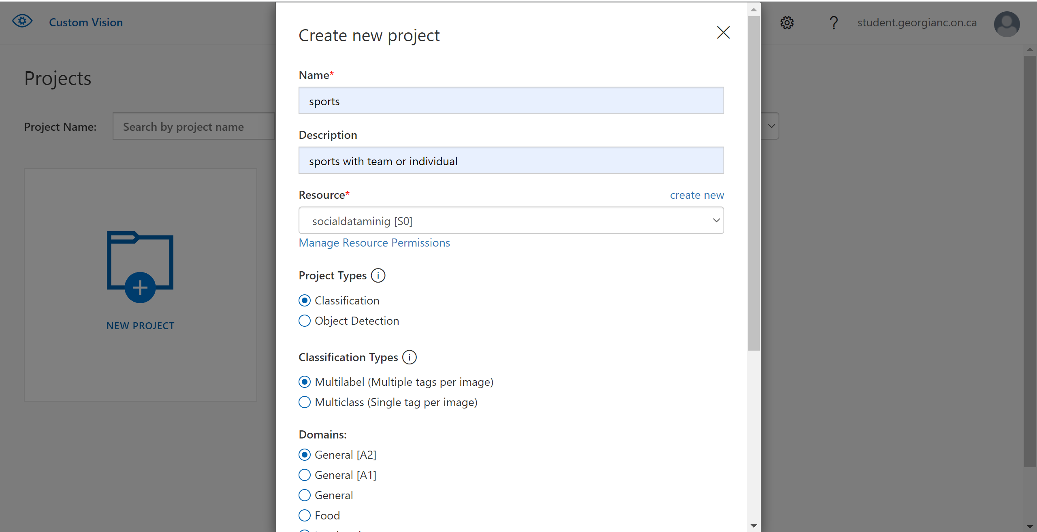
CUSTOM VISION AI
After cick the new Project
Name and description
Multilable part

Slide 4
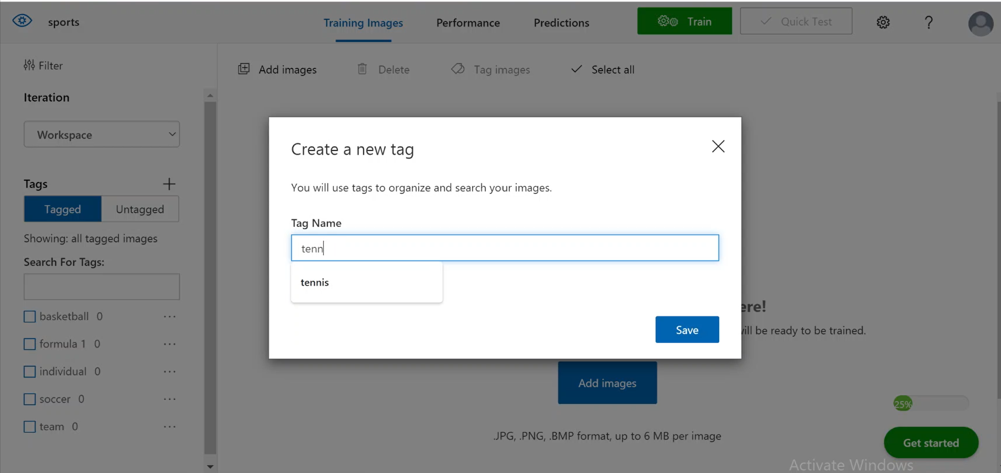
CUSTOM VISION AI
Add tags

Slide 5

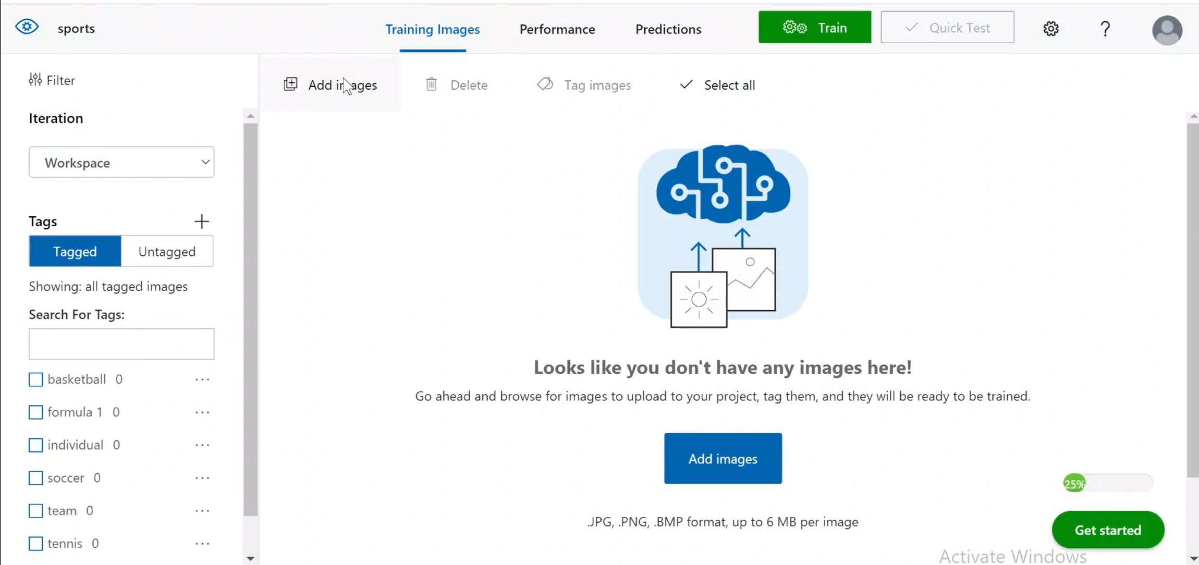
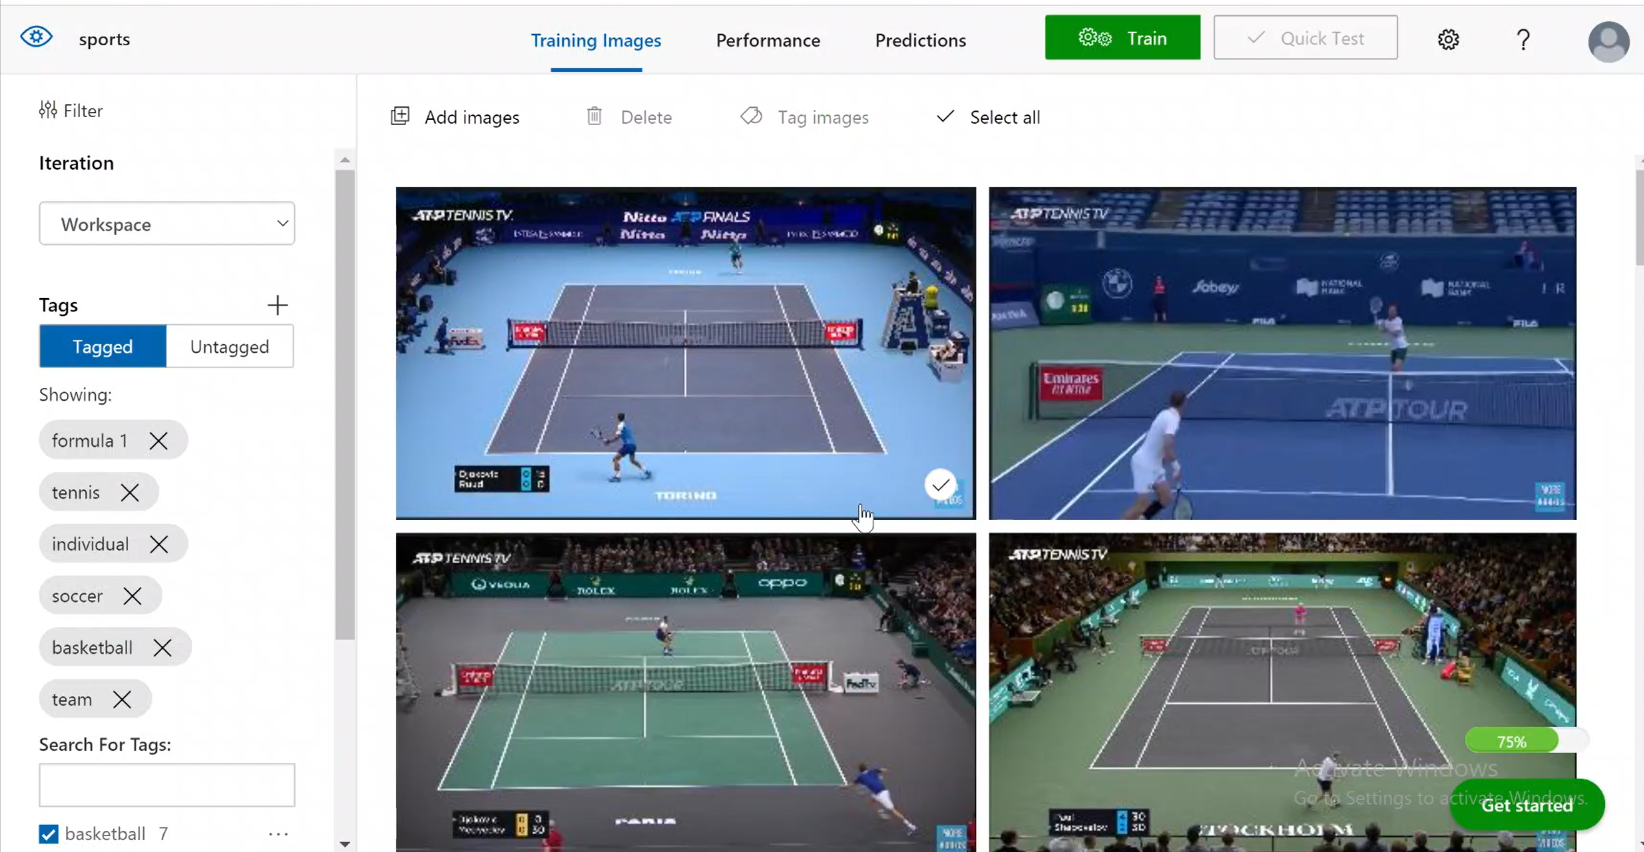
CUSTOM VISION AI
Add images

Slide 6
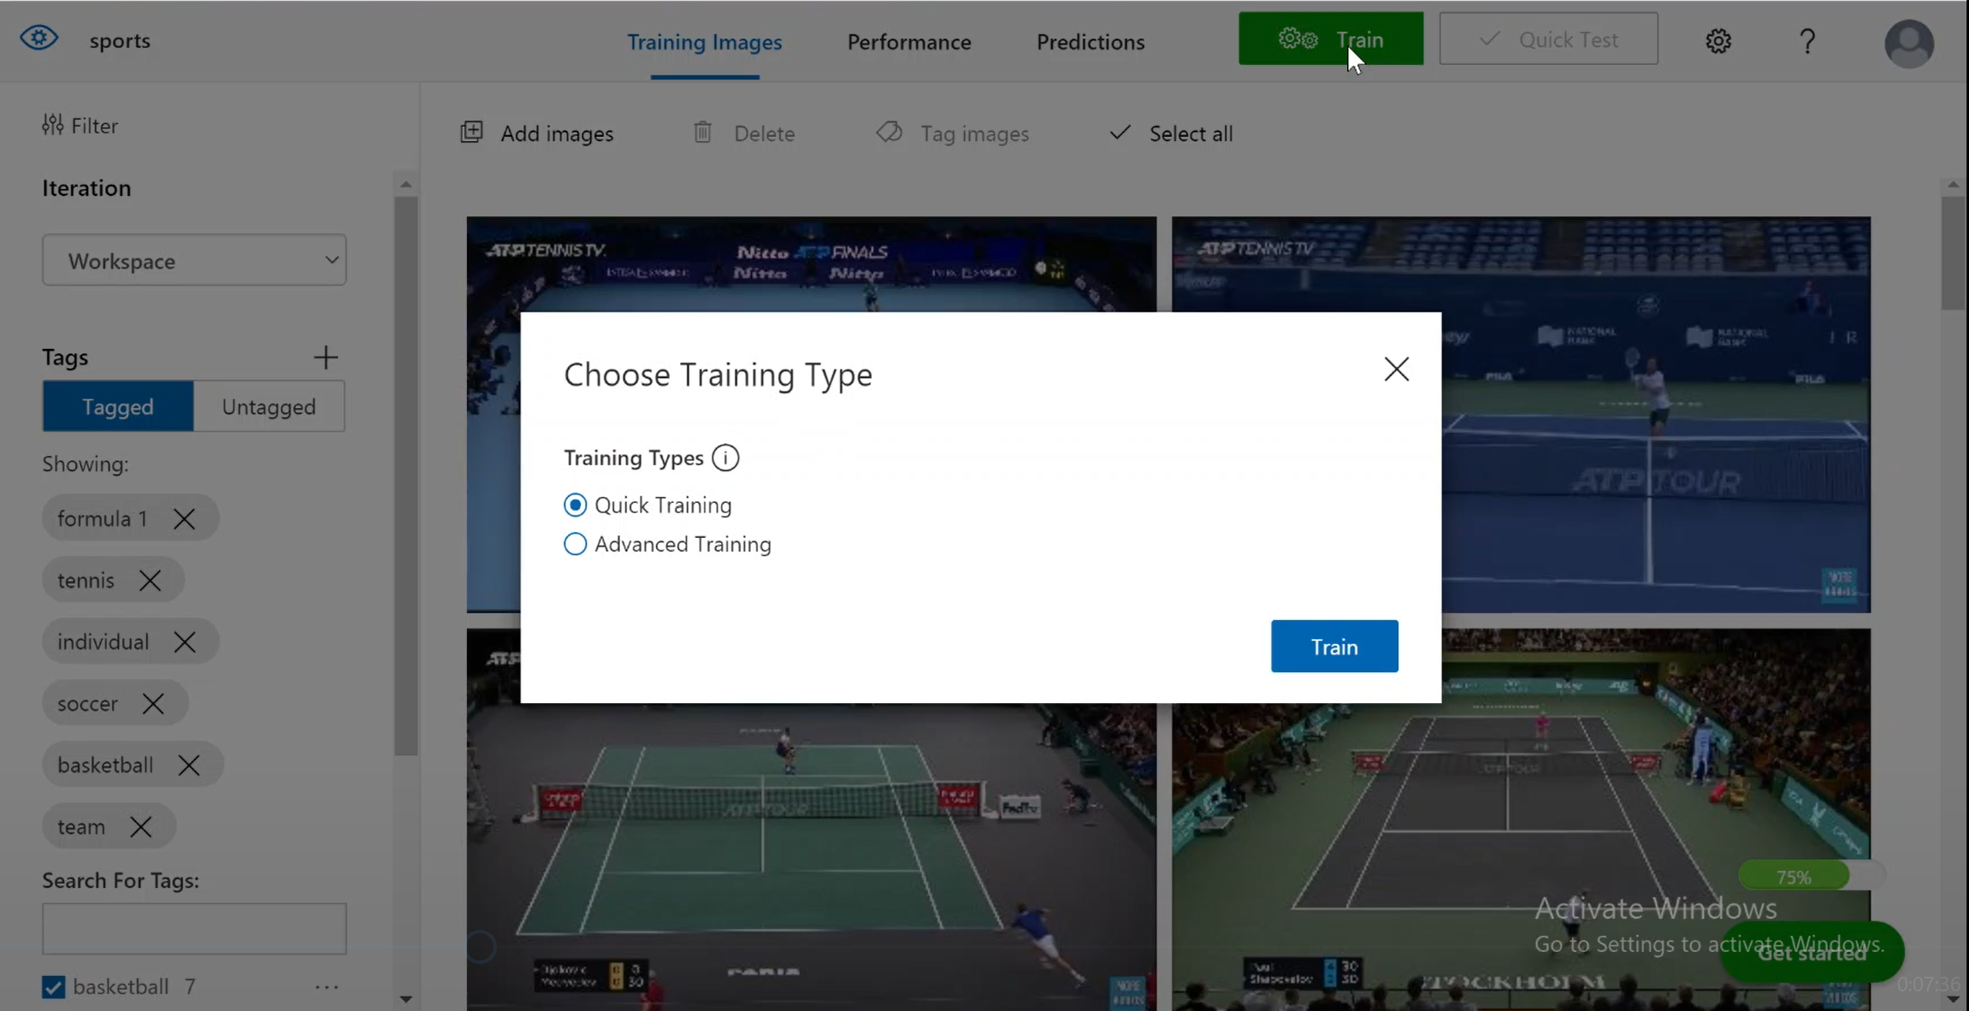
CUSTOM VISION AI
Train part

Slide 7
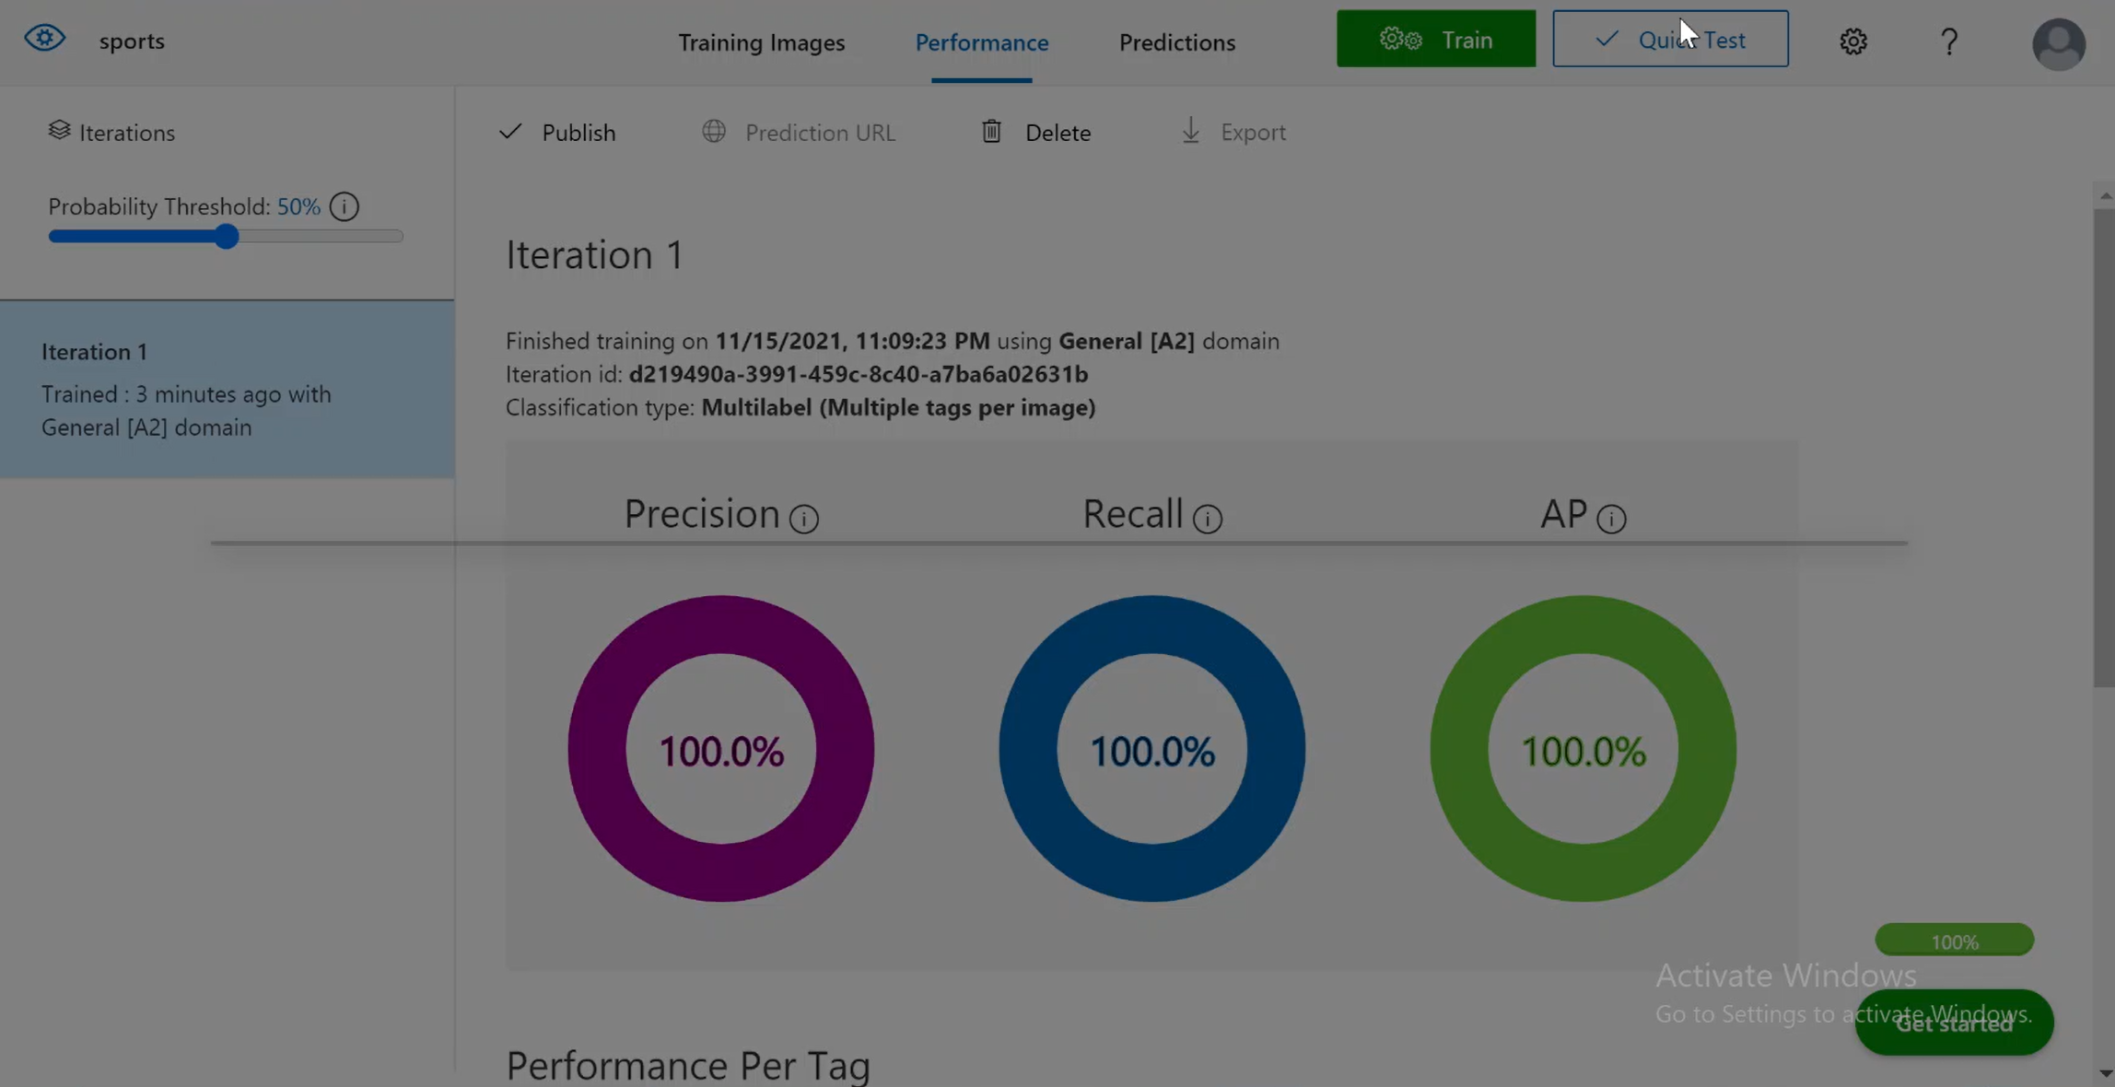
CUSTOM VISION AI
Quic test

Slide 8
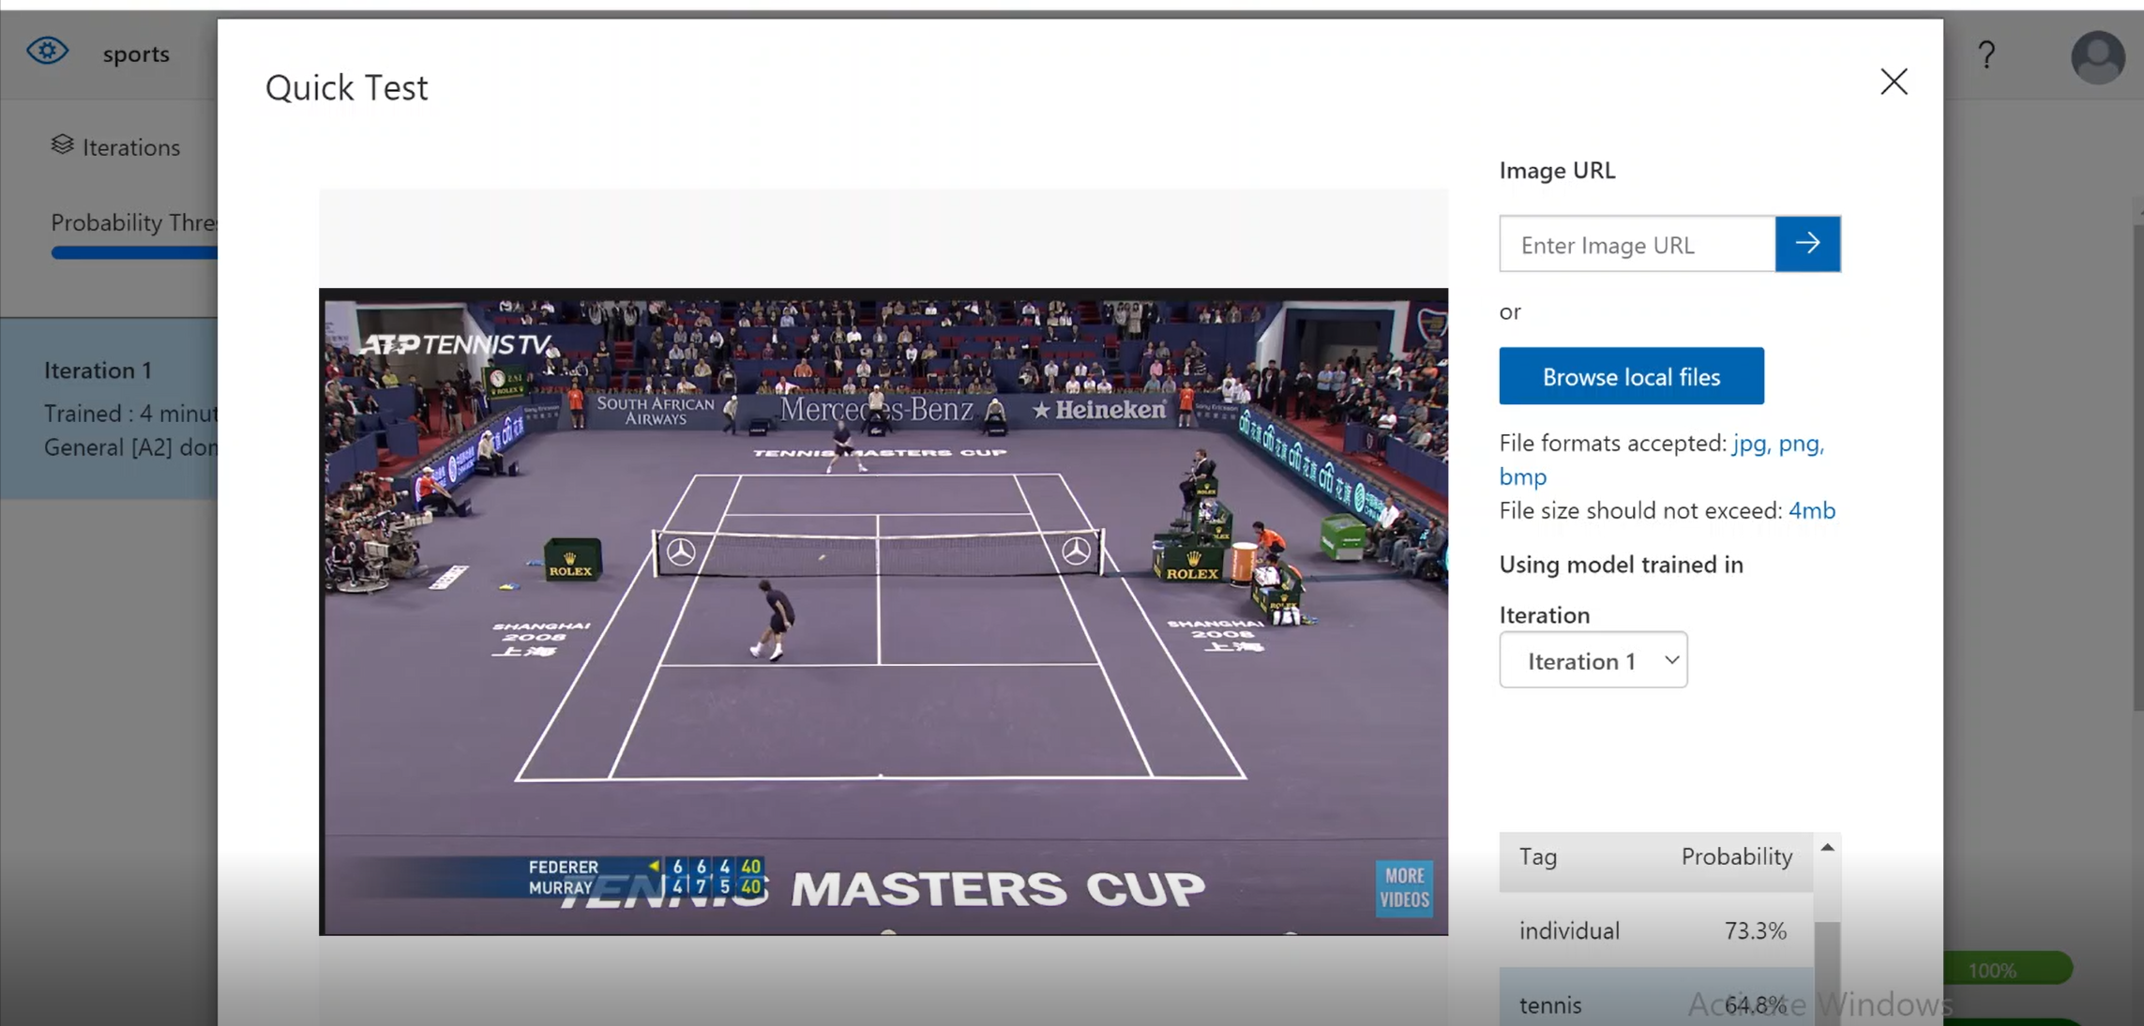
CUSTOM VISION AI
Upload images for test

Slide 9
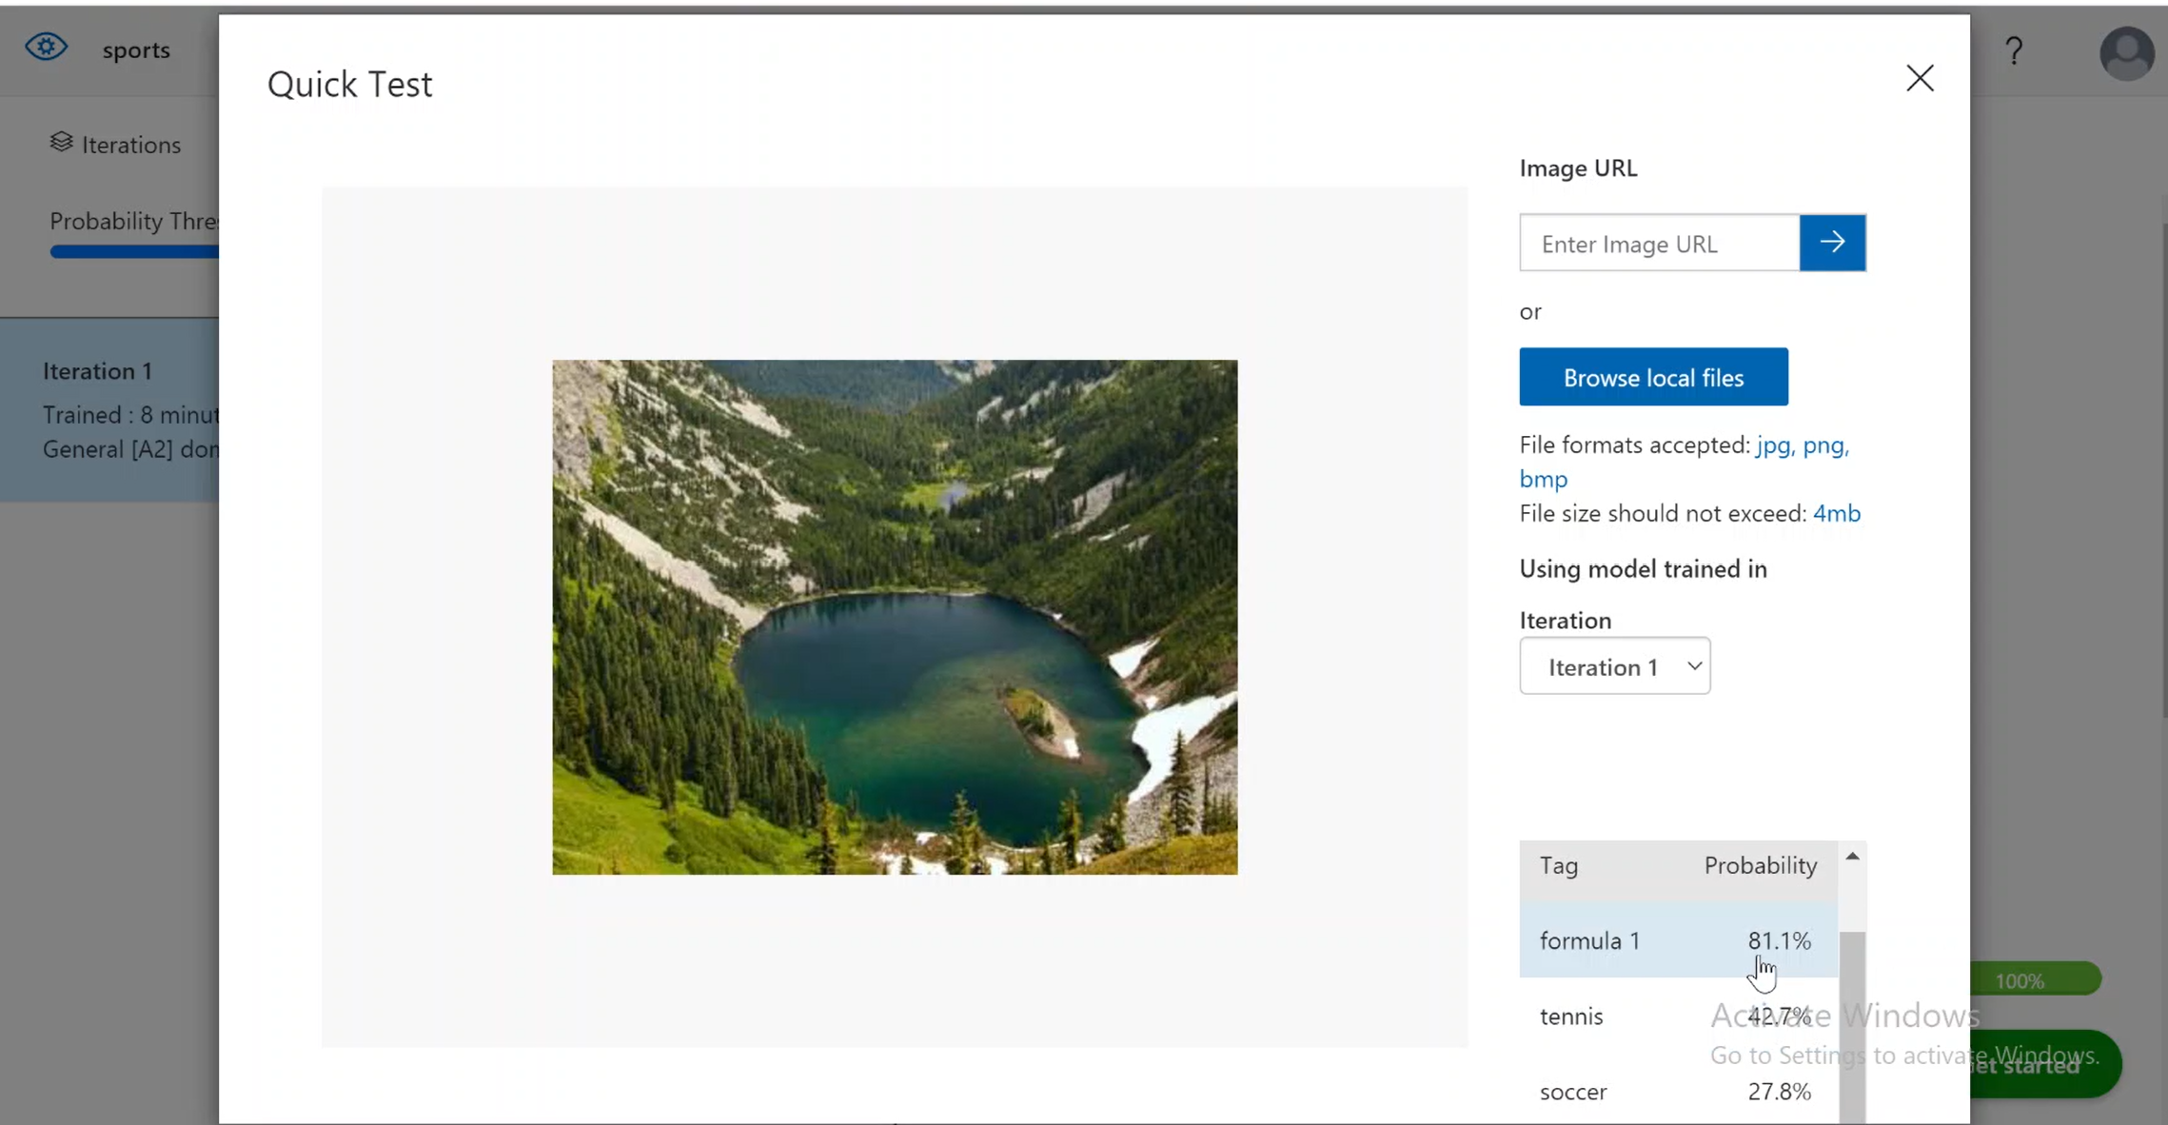
CUSTOM VISION AI
Upload images for test

Slide 10
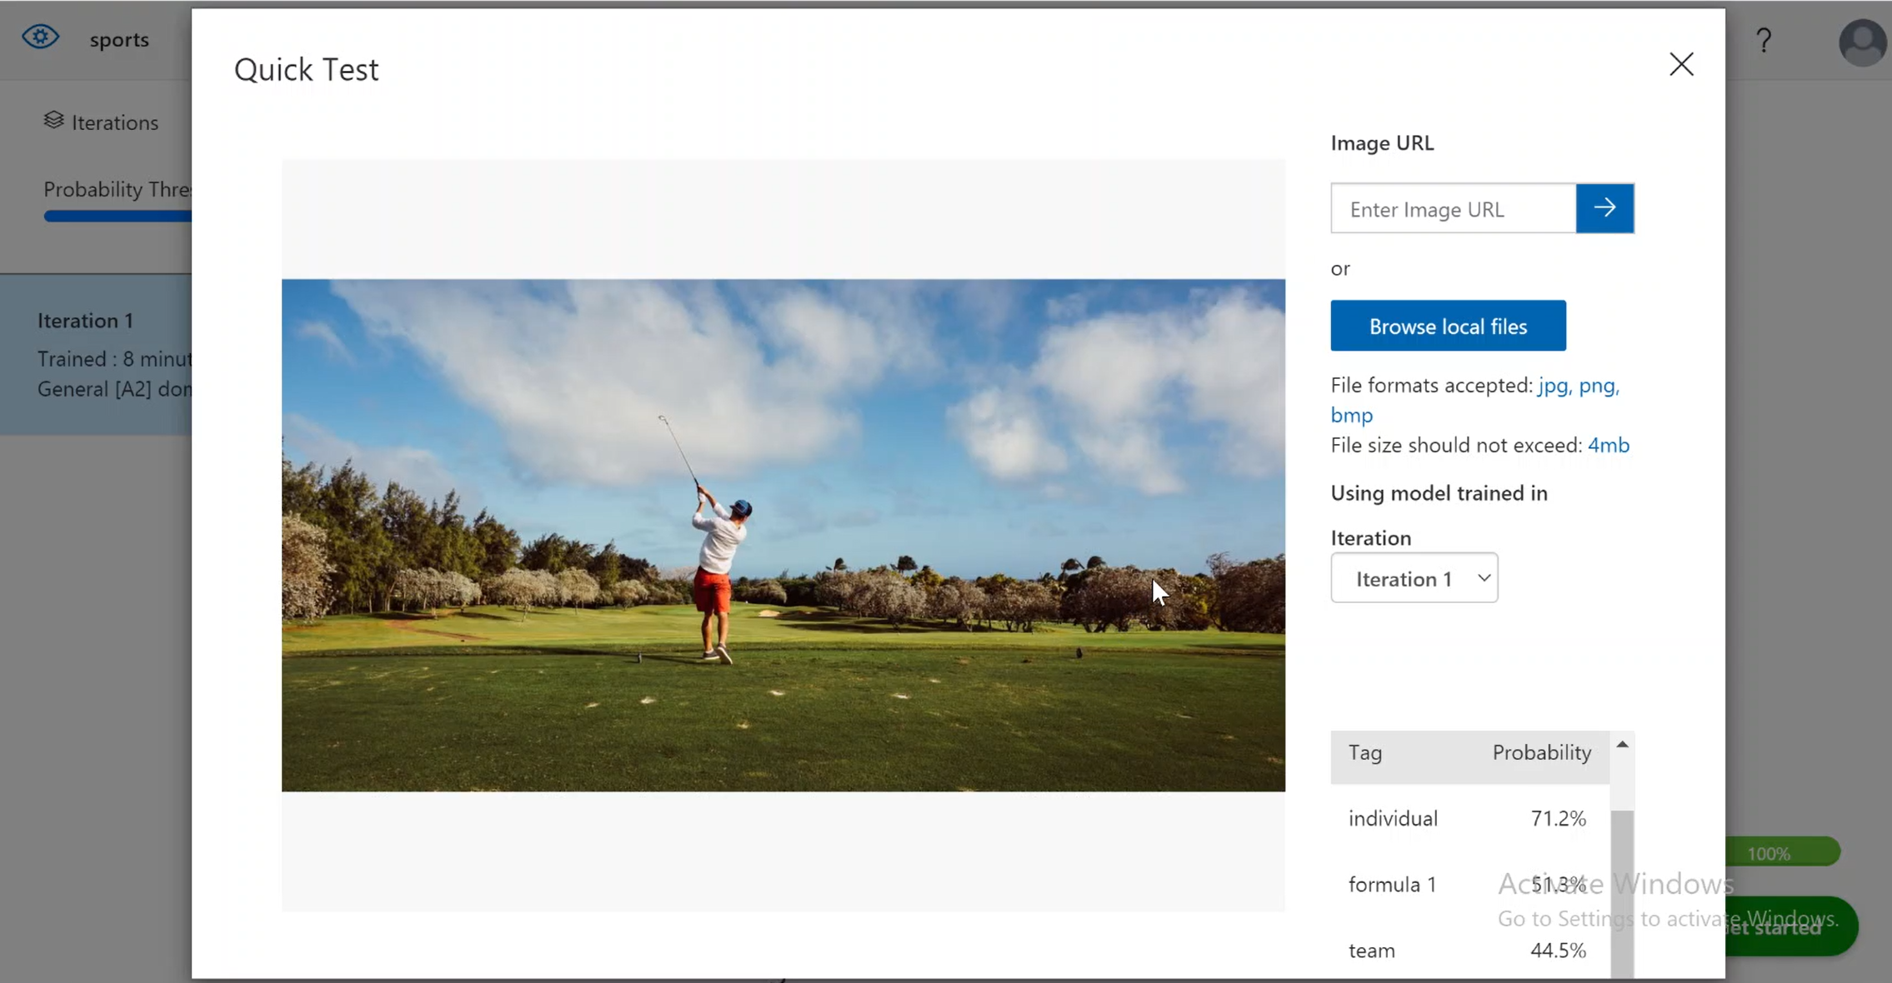
CUSTOM VISION AI
Upload images for test

Slide 11
CUSTOM VISION AI
Link for video presentation
https://www.youtube.com/watch?v=Kmo3m8nbL3I

